Slide 1
PROJECT TITLE
Surprise Housing - Housing Price Predication & Analysis Project
Submitted By:
Submitted to:
Ms. Hritik yadav
MS. khushboo gargh

Slide 2
Acknowledgement
I WOULD LIKE TO GAVE MY GRATITUDE TO ‘FLIP ROBO’ WHO GAVE THIS WONDERFULL OPPORTUNITY TO WORK ON THIS DATASET PROJECT ASLO HEARTFUL THANK TO ‘KHUSHBOO MAM’ TO CLEAR MY CONFUSIONS AND DOUBTS.
THE SKILLS WHICH USE TO COMPLETE THE PROJECT
DATA VISULIZATION- MATPLOTLIB, SEABORN
PANDAS LIBRARY
NUMPY LIBRARY
EDA KNOWLEDGE
MACHINE LEARNING

Slide 3
INTRODUCTION
•Business Problem Framing
Real Estate Property is not only the basic need of a man but today it also represents the riches and prestige of a person. Investment in real estate generally seems to be profitable because their property values do not decline rapidly. The market demand for housing is always increasing every year due to increase in population and migrating to other cities for their financial purpose. Changes in the real estate price can affect various household investors, bankers, policy makers and many. Investment in Housing seems to be an attractive choice for the investments.
Houses are one of the necessary needs of each and every person around the globe and therefore housing and real estate market is one of the markets which is one of the major contributors in the world’s economy. It is a very large market and there are various companies working in the domain. Data science comes as a very important tool to solve problems in the domain to help the companies increase their overall revenue, profits, improving their marketing strategies and focusing on changing trends in house sales and purchases.
In general, purchasing and investing in any real estate project will involve various transactions between different parties. Thus, it could be a vital decision for both households and enterprises. How to construct a realistic model to precisely predict the price of real estate has been a challenging topic with great potential for further research.
There are many factors that have an impact on house prices, such as the number of bedrooms and bathrooms. House price depends upon its location as well. A house with great accessibility to highways, schools, malls, employment opportunities, would have a greater price as compared to a house with no such accessibility.

Slide 4
improving their marketing strategies and focusing on changing trends in house sales and purchases.
In general, purchasing and investing in any real estate project will involve various transactions between different parties. Thus, it could be a vital decision for both households and enterprises. How to construct a realistic model to precisely predict the price of real estate has been a challenging topic with great potential for further research.
There are many factors that have an impact on house prices, such as the number of bedrooms and bathrooms. House price depends upon its location as well. A house with great accessibility to highways, schools, malls, employment opportunities, would have a greater price as compared to a house with no such accessibility.
Regression is a supervised learning algorithm in machine learning which is used for prediction by learning and forming a relationship between present statistical data and target value i.e., Sale Price in this case. Different factors are taken into consideration while predicting the worth of the house like location, neighbourhood and various amenities like garage space etc. if learning is applied to above parameters with target values for a certain geographical region as different areas differ in price like land price, housing style, material used, availability of public utilities.

Slide 5
Conceptual Background of the Domain Problem
A US-based housing company named Surprise Housing has decided to enter the Australian market. The company uses data analytics to purchase houses at a price below their actual values and flip them at a higher price. For the same purpose, the company has collected a data set from the sale of houses in Australia. The data is provided in the CSV file below. The company is looking at prospective properties to buy houses to enter the market. You are required to build a model using Machine Learning in order to predict the actual value of the prospective properties and decide whether to invest in them or not.
For this company wants to know:
▪ Which variables are important to predict the price of variable?
▪ How do these variables describe the price of the house?
It is required to model the price of houses with the available independent variables. This model will then be used by the management to understand how exactly the prices vary with the variables. They can accordingly manipulate the strategy of the firm and concentrate on areas that will yield high returns. Further, the model will be a good way for the management to understand the pricing dynamics of a new market.

Slide 6
Review of Literature
Related Work or Literature survey is the most important step in any kind of research. Before start developing Machine Learning Model, we need to study the previous papers of our domain which we are working and on the basis of study we can predict or generate the drawback and start working with the reference of previous papers. In this section, we briefly review the related work on house price prediction and the techniques used. Predicting house prices manually is a difficult task and generally not very accurate, hence there are many systems developed for house price prediction.
Sifei Lu, Zengxiang Li, Zheng Qin, Xulei Yang, Rick Siow Mong Goh [6] had proposed an advanced house prediction system using linear regression. This system’s aim was to make a model that can give us a good house price prediction based on other variables. This paper proposed on Hybrid Regression technique for housing Prices Prediction focused on the use of creative feature engineering to find the optimal features and their correlation with Sales Prices. Feature engineering improved the data normality and linearity of data. Their system showed that working on the Ames Housing dataset was convenient and showed that the use of Hybrid algorithms (65% Lasso and 35% Gradient Boost) provided results in predicting the house prices rather than using one from lasso, ridge or gradient boost.

Slide 7
CH.Raga Madhuri, Anuradha G et.al [7], estimated house price by the analysis of fare ranges, foregoing merchandise and forewarns of developments. The author discussed diverse regression techniques such as Gradient boosting and AdaBoost Regression, Ridge, Elastic Net, Multiple linear, LASSO to locate the most excellent. The performance measures used are [MSE] Mean Square Error and [RMSE] Root Mean Square Error.
Zhongyun, Jiang, Guoxin, Shen [8], develops 6-layer BP neural network with Kera's deep learning. For backend Tens flow or Theano is used. The test results give the predict real value of house with accuracy of 95.59%. The Gaussian noise model is favourable for the house price forecast.
Zhen Peng, Qiang Huang, Yincheng Han [9], precisely study the cost of recycled houses, and examined 35417 bits of information caught by the Chengdu HOME LINK organization. First and foremost, the caught information was cleaned, and the attributes were chosen. The test results show that the precision of XGboost expectation is the most elevated, and the forecast exactness score arrives at 0.9251. Dissimilarity with linear regression, decision tree model, the XGboost algorithm gives improved speculation capacity and strength in information forecast, and, furthermore, data prediction over-fitting aspect, establishing a strong framework for the ensuing recycled house value expectation.

Slide 8
Liu et al. [10] have constructed a statistical model based on the fuzzy neural network prediction model, which incorporates the hedonic theory and a great database with relevant characteristics affecting the price of properties based on recently sold projects. The experimental outcome and analysis have shown that the fuzzy neural network prediction model has a promising ability for real estate price prediction given reliable input data with high quality.
According to Kusan et al. [11], factors affecting housing sale price can be classified into three types: house factors, environmental factors, and transportation factors. The most influential type is residential factors, including residence, usability, and number of rooms. When people consider purchasing a house for living purposes, the factors above are the main determinants for the living quality. Buyers with family members would typically attach more importance to the essential feature of the house, like the living area and number of rooms, which have a significant impact on the overall living quality and experience in the house. Besides, the intangible features, like the view of residence and usability, also have a rather considerable influence on the housing price, through affecting buyers’ experience on the house and willingness to pay. The other influential types are the main factors related to building properties and floor factors. Building properties are mainly about hardware and basic facilities in the building, such as the

Slide 9
elevator, generator, and garage. The rising trend of numbers of vehicles per household possessing generates a necessary demand for the quality and capacity of a garage in a house. Other affiliated facilities to the house like the swimming pool and backyard have also played an essential role in determining the housing price, as the demand for leisure and relaxation has been arising with the economic progress. On the other hand, floor factors, like the number of floors, have also impacted the housing price significantly. A family with children and elders tends to prefer a house with multi floor construction, which offers different family members separate living areas with appropriate privacy while living together. Environmental factors mainly consist of two parts: regional environment and nearby pollution. Regional Scientific Pro environment refers to the overall living conditions in the surrounding community. Sanitation, as a significant indicator of the living quality, has been given more importance in the recent decades. A community with comprehensive sanitation services tends to attract buyers to pay a higher price.According to the paper proposed by Ayush Varma et. al. [12] suggested that the use of neural networks along with linear and boosted algorithms improved prediction accuracy. Three algorithms were used namely Linear Regression, Forest Regression and Boosted Regression. The dataset was tested on all three and the results of all the above algorithms were fed as an input to the neural network. Neural networks were used

Slide 10
mainly to compare all the predictions and display the most accurate result. A neural network along with Boosted Regression was used to increase the accuracy of the result.
Another research study showed that there exist relationships between the visual appearance and non-visual attributes such as crime statistics, housing prices, population density, etc. of a city. For instance, “City Forensics: Using Visual Elements to Predict Non-Visual City Attributes” [13], uses visual attributes to predict the sale price of the property.
1.4 Motivation for the Problem Undertaken
The project is provided to me by Flip Robo Technologies as a part of the internship programme. The exposure to real world data and the opportunity to deploy my skillset in solving a real time problem has been the primary motivation.
Our main objective of doing this project is to build a model to predict the house prices with the help of other supporting features. In order to improve the selection of customers, the client wants some predictions that could help them in further investment and improvement in selection of customers.
The No Free Lunch Theorem state that algorithms perform differently when they are used under the same circumstances. This study aims to analyse & predicting house price

Slide 11
when using Multiple linear, Lasso, Ridge, XGBoost, Random Forest regression and Extra Tree Regressor algorithms. Thus, the purpose of this study is to deepen the knowledge in regression methods in machine learning.
In addition, the given datasets should be processed to enhance performance, which is accomplished by identifying the necessary features by applying one of the selection methods to eliminate the unwanted variables since each house has its unique features that help
to estimate its price. These features may or may not be shared with all houses, which means they do not have the same influence on the house pricing resulting in inaccurate output.
The study answers the following research questions:
- Research question 1: Which machine learning algorithm performs better and has the most accurate result in house price prediction? And why?
- Research question 2: What are the factors that have affected house prices in Australia over the years?

Slide 12
Analytical Problem Framing
1. Mathematical / Analytical Modelling of the Problem
Our objective is to predict House price which can be resolve by use of regression-based algorithm. In this project we are going to use different types of algorithms which uses their own mathematical equation on background. This project comes with two separate data set for training & testing model. Initially data cleaning & pre-processing perform over data. Feature engineering is performed to remove unnecessary feature & for dimensionality reduction. In model building Final model is select based on evaluation benchmark among different models with different algorithms. Further Hyperparameter tuning performed to build more accurate model out of best model.
2. Data Sources and their formats
Data set provided by Flip Robo was in the format of CSV (Comma Separated Values). There are 2 data sets that are given. One is training data and one is testing data.
1) Train file will be used for training the model, i.e., the model will learn from this file. It contains all the independent variables and the target variable. The dimension of data is 1168 rows and 81 columns.
2) Test file contains all the independent variables, but not the target variable. We will apply the model to predict the target variable for the test data. The dimension of data is 292 rows and 80 columns.

Slide 13
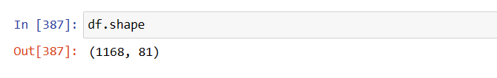

Slide 14
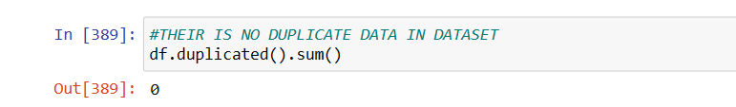
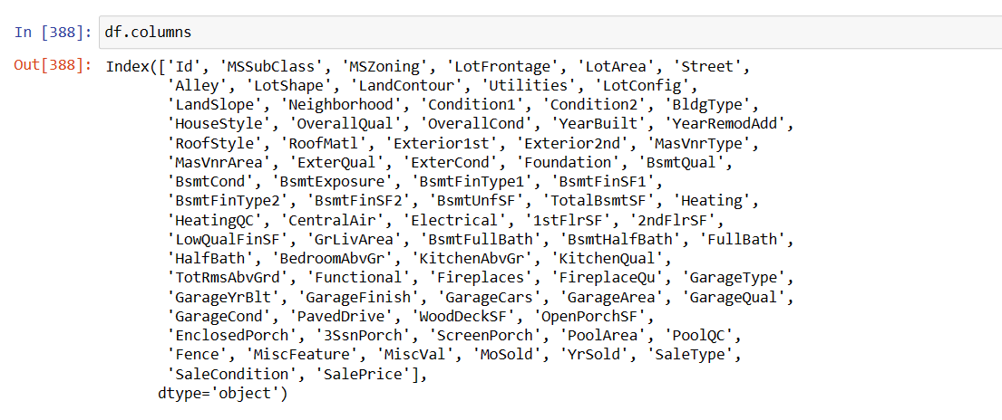
THEIR IS NO DUPLICATE IN THE DATA SET
THE COLUMNS NAME IN THE DATASET

Slide 15
3. Data Pre-processing
The dataset is large and it may contain some data error. In order to reach clean, error free data some data cleaning & data pre-processing performed data.
CHECK NAN VALUES IN THE DATASET
SOME FEATURES CONTAIN NULL VALUE WITH HEAT MAP

Slide 16
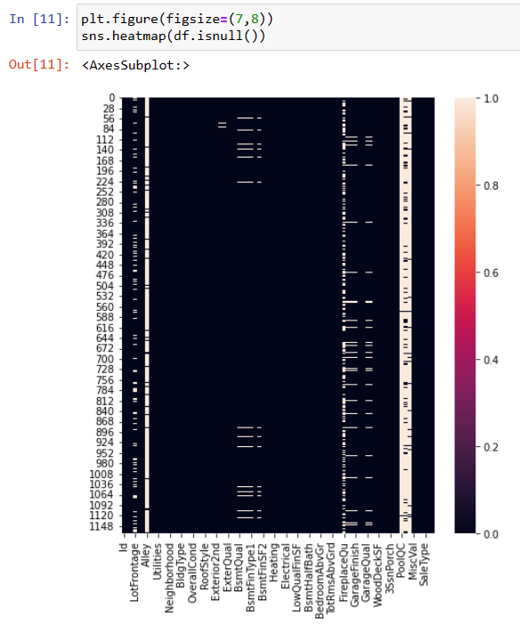

Slide 17
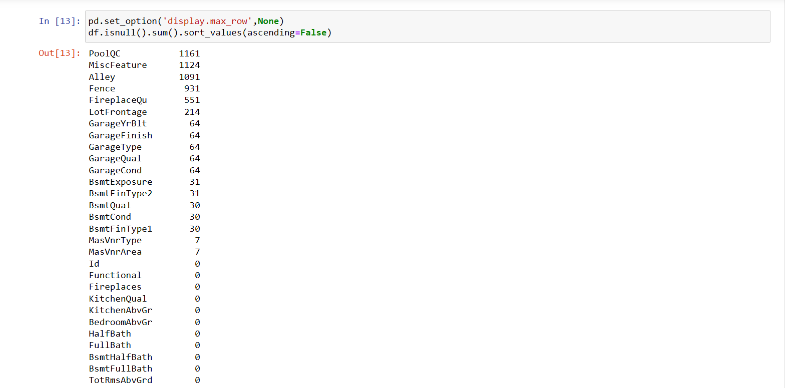

Slide 18
OBSERVATION:-
MasVnrType - 7
MasVnrArea - 7
BsmtQual - 30
BsmtCond - 30
BsmtFinType1 - 30
BsmtFinType2 - 31
BsmtExposure - 31
GarageQual - 64
GarageFinish - 64
GarageYrBlt - 64
GarageCond - 64
GarageType - 64
LotFrontage - 214

Slide 19
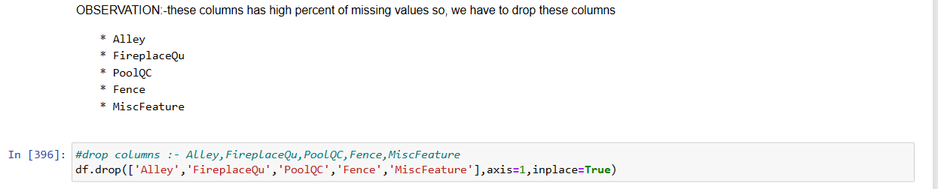
We have removed feature which contain high amount missing values e.g., Top 5 features with missing value in above list. Rest of feature are handle based on mean, median or mode imputation depending on outliers & distribution of feature.

Slide 20
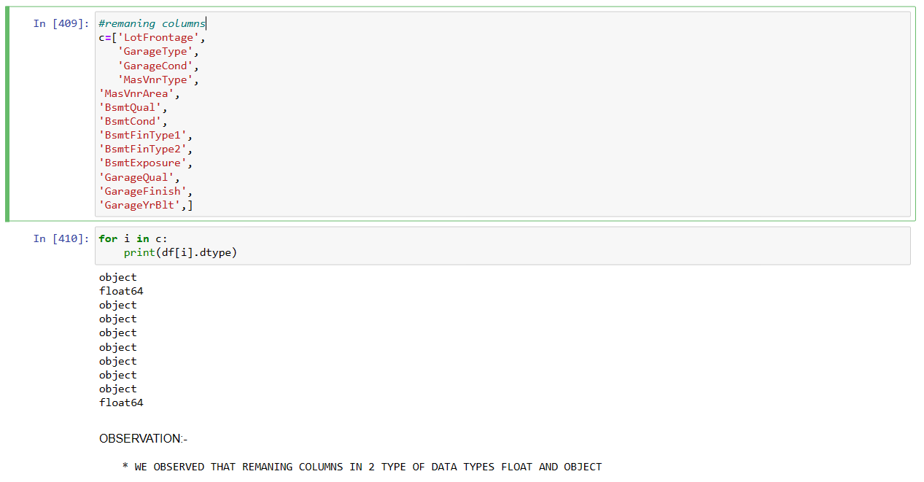
NOW FILL THE REMAINNG FEATURES WITH MEDIAN MODE

Slide 21
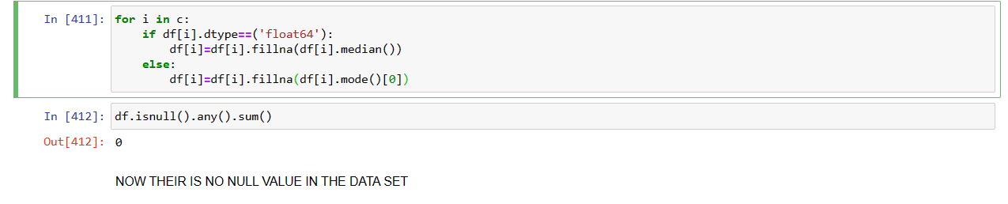

Slide 22
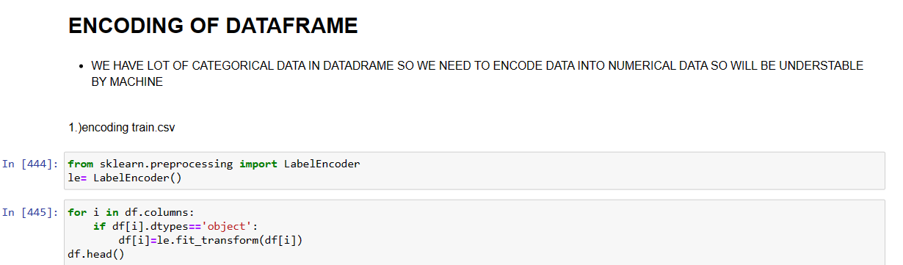
▪ Label Encoding of Categorical features:
The categorical Variable in training & testing dataset are converted into numerical datatype using label encoder from scikit library

Slide 23
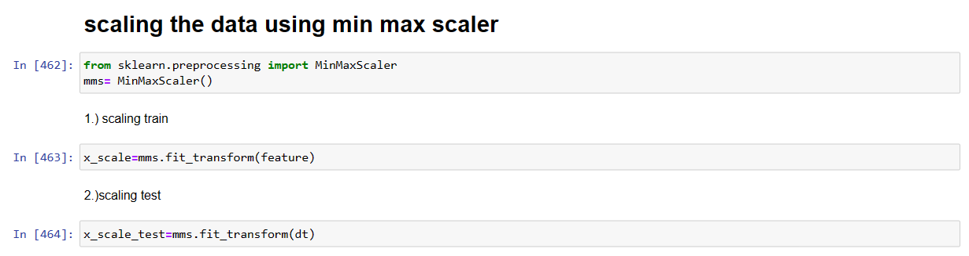
▪ Standard Scaling:

Slide 24
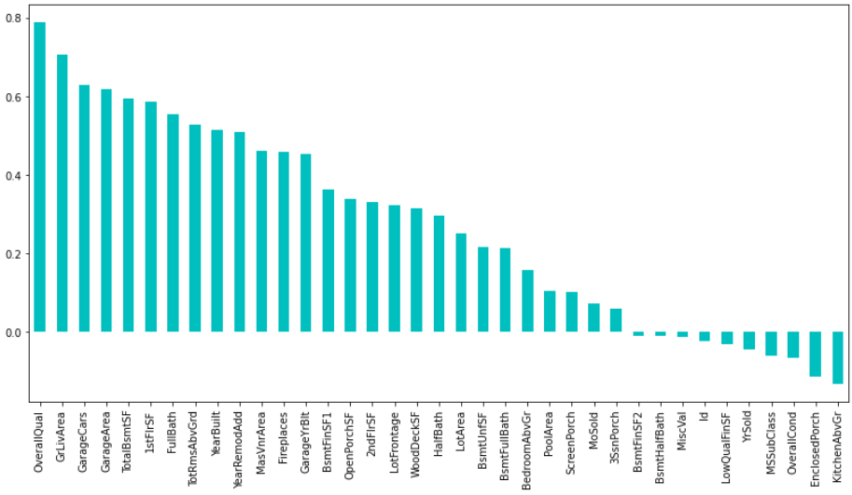
Data Inputs- Logic- Output Relationships
Correlation heatmap is plotted to gain understanding of relationship between target features & independent features. We can see that lot of features are highly correlated with target variable Sale Price. To gain insights about relationship between Input & output different types of visualization are plotted which we will see in EDA section of this report

Slide 25
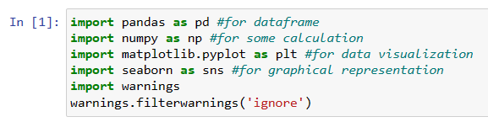
Hardware & Software Requirements with Tool Used
Hardware Used -
1. Processor — Intel i3 processor with 2.4GHZ
2. RAM — 4 GB
3. GPU — 2GB AMD Radeon Graphics card
Software utilised -
1. Anaconda – Jupyter Notebook
2. Google Colab – for Hyper parameter tuning
Libraries Used – General libraries used for data wrangling
Libraries used

Slide 26
Libraries used for machine learning model building

Slide 27
Models Development & Evaluation
1. Identification Of Possible Problem-Solving Approaches (Methods)
Our objective is to predict house price and analyse feature impacting Sale price. This problem can be solve using regression-based machine learning algorithm like linear regression. For that purpose, first task is to convert categorical variable into numerical features. Once data encoding is done then data is scaled using standard scalar. Final model is built over this scaled data. For building ML model before implementing regression algorithm, data is split in training & test data using train_test_split from model_selection module of sklearn library.
Cross-validation is primarily used in applied machine learning to estimate the skill of a machine learning model on unseen data. That is, to use a limited sample in order to estimate how the model is expected to perform in general when used to make predictions on data not used during the training of the model. After that model is train with various regression algorithm and 5-fold cross validation is performed. Further Hyperparameter tuning performed to build more accurate model out of best model.
2. Testing of Identified Approaches (Algorithms)
The different regression algorithm used in this project to build ML model are as below:
❖ Linear Regression
❖ Random Forest Regressor
❖ Decision Tree Regressor
❖ Ridge Regression
❖ XGB Regressor
❖ Extra Tree Regressor

Slide 28
KEY METRICS FOR SUCCESS IN SOLVING PROBLEM UNDER CONSIDERATION
Following metrics used for evaluation:
1. Mean absolute error which gives magnitude of difference between the prediction of an observation and the true value of that observation.
2. Root mean square error is one of the most commonly used measures for evaluating the quality of predictions.
3. R2 score which tells us how accurate our model predict result, is going to important evaluation criteria along with Cross validation score.
4. Cross Validation Score
RUN AND EVALUATE SELECTED MODELS
1. Linear Regression:

Slide 29
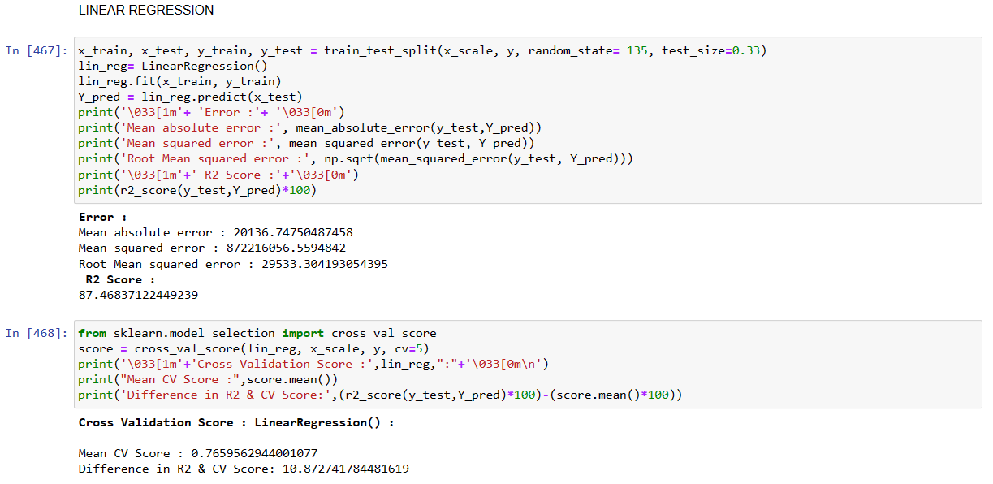

Slide 30
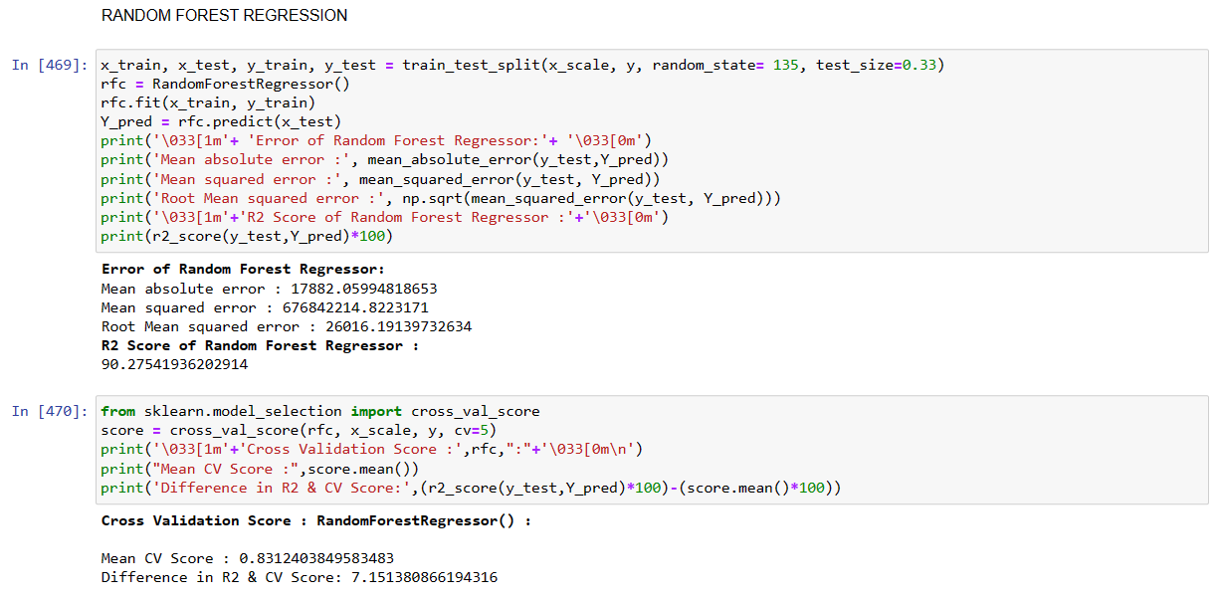
2. Random Forest Regressor

Slide 31
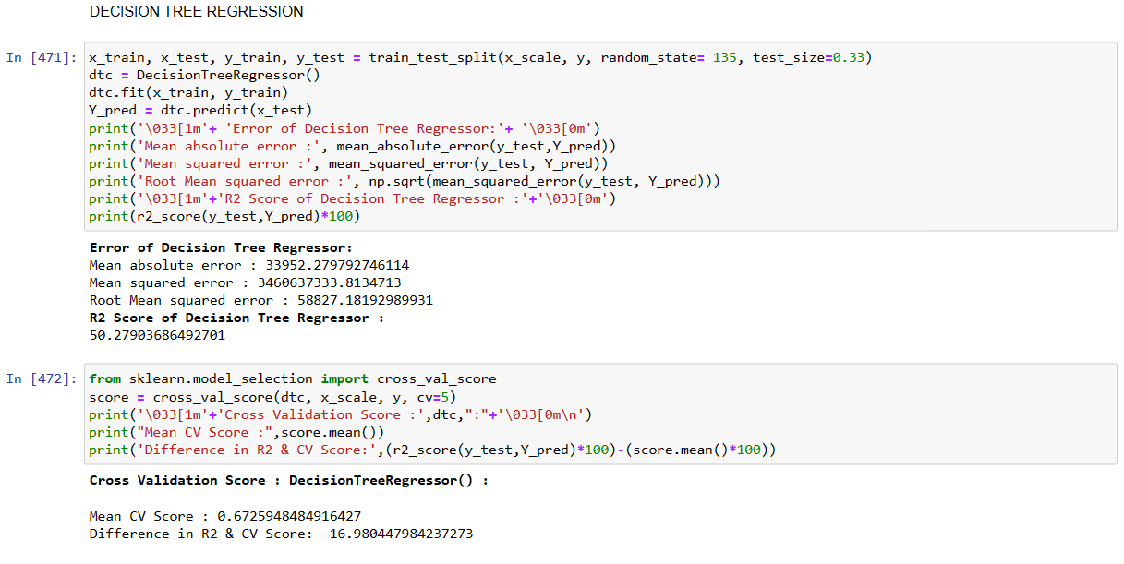
3. Decision Tree Regressor

Slide 32
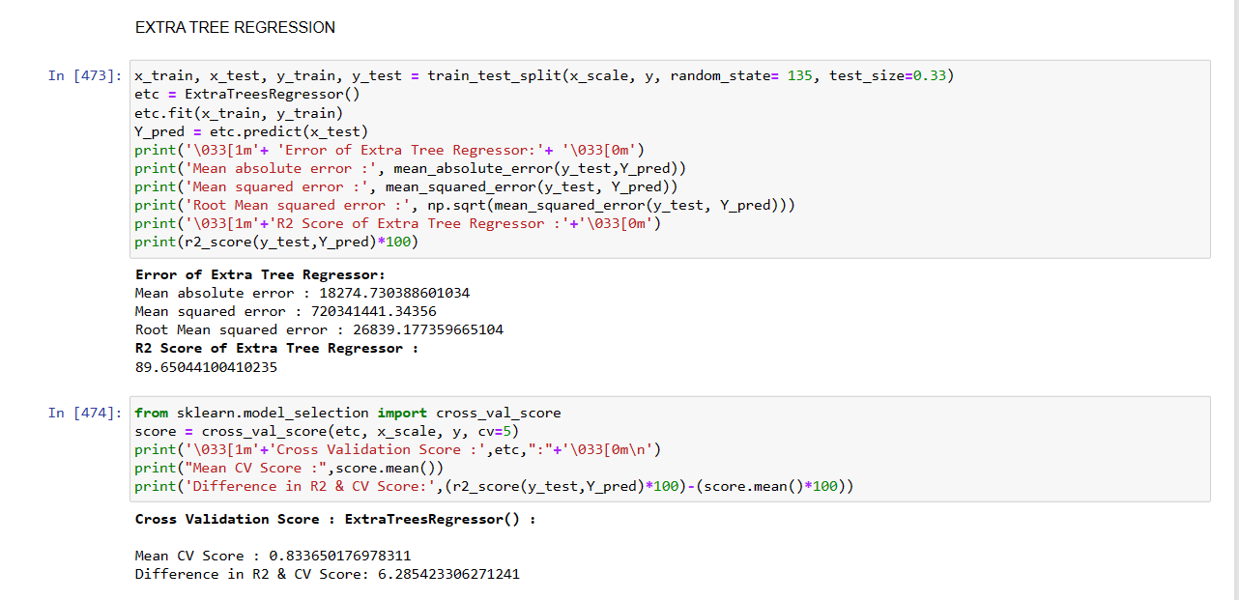
4. Extra Trees Regressor:

Slide 33
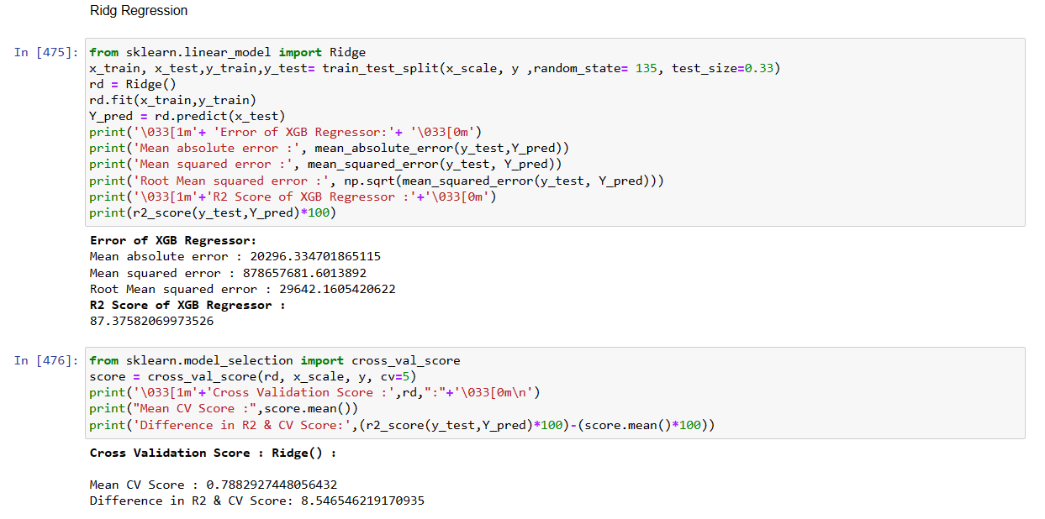
5. Ridge Regressor:

Slide 34
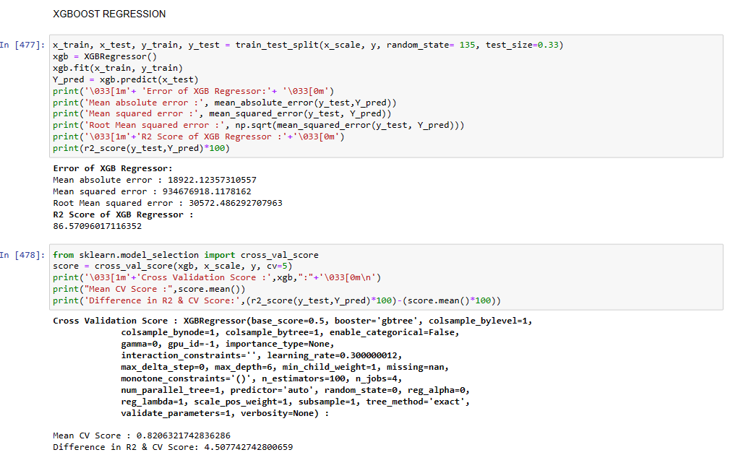
6. XGB Regressor:

Slide 35
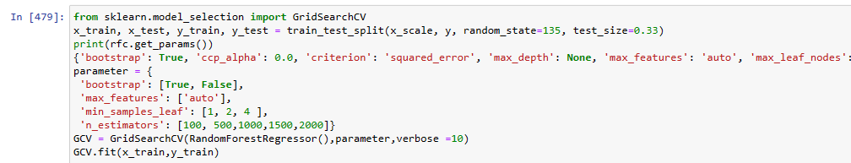
5-Fold cross validation performed over all models. We can see that Random Forest Regressor gives maximum R2 score of 90.27 and with cross validation score of 83.12 %. Among all model we will select Random Forest Regressor as final model and we will perform hyper parameter tuning over this model to enhance its R2 Score.

Slide 36
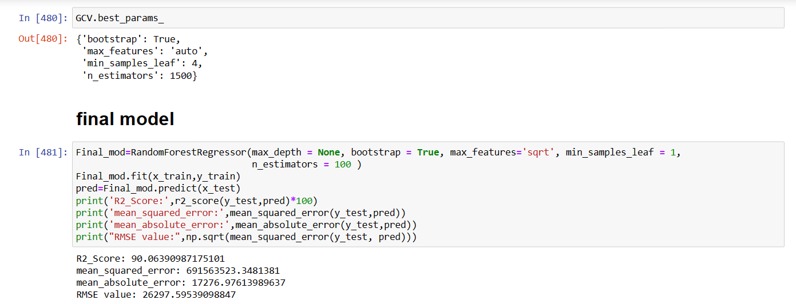
Final model is built with best params got in hyper parameter tuning

Slide 37
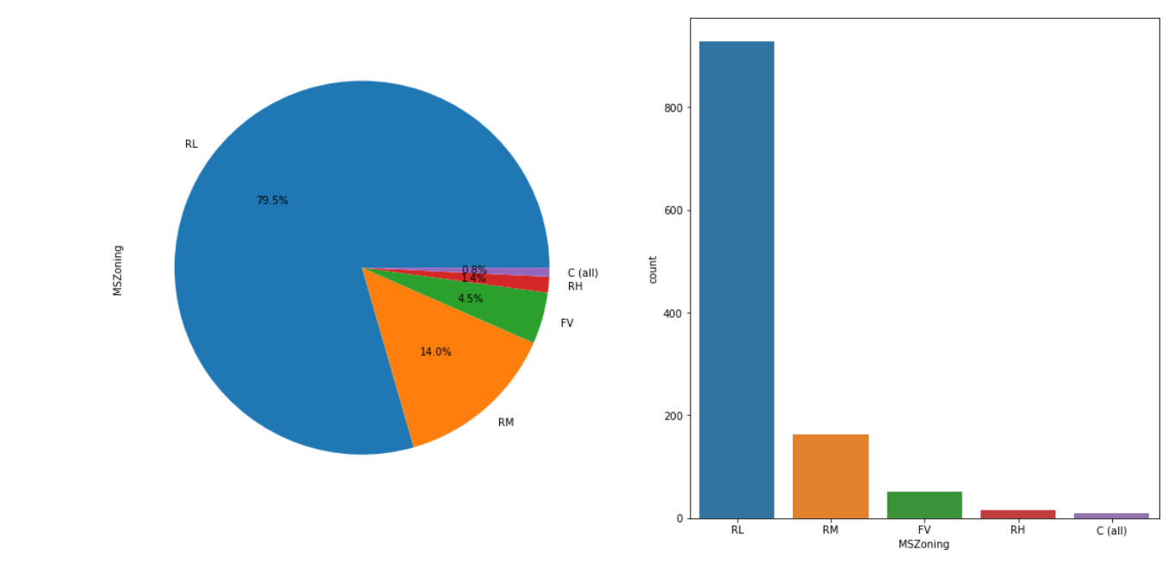
We can see that hyper parameter tuning leading to increase in R2 Score slightly from default model.
VISUALIZATIONS
1. MSZoning

Slide 38
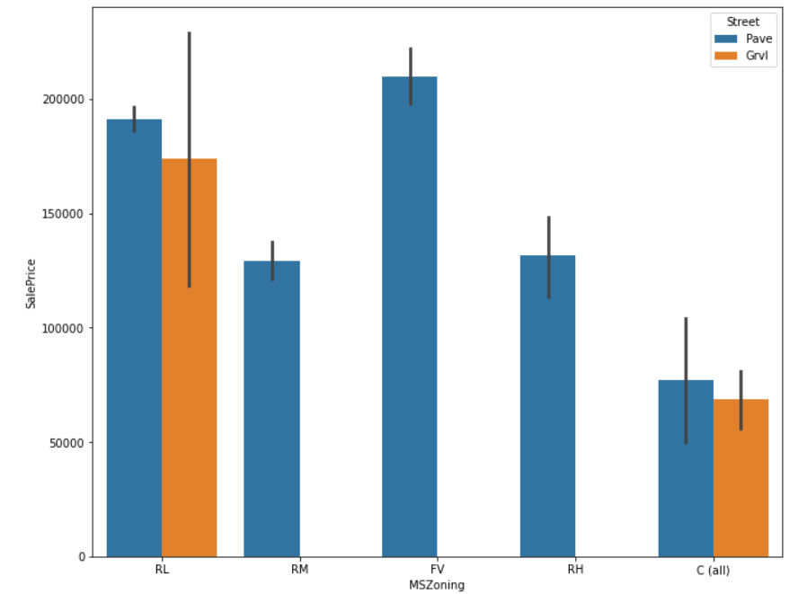
FEATURES:-
*Reg-Regular
*IR1-Slightly irregular
*IR2-Moderately Irregular
*IR3-Irregular
OBSERVATION:-
* 63% REGULAR SHAPE TAKE PLACE
* BUT SALE OF MODERATELY IRREGULAR IS HIGHEST THEN FOLLOWED BY SLIGHTLY IRREGULAR
NOW LETS UNDERSTAND SALE PRICE ON DIFFERENT PERAMETERS

Slide 39
OBSERVATION:-
* AS WE SHOW IN FIGURE Floating Village Residential HAS HIGHEST THEN Residential Low Density.
* IN Floating Village Residential AREA ONLY PAVED ROAD PRESENT
* IN Residential Low Density AREA PAVED ROAD SIGHTLY HIGHER THEN GRAVEL
ON THE BASIS OF QUALITY AND CONDITION
OBSERVATION:-
* the overall material and finish of the houses(overall qual) is better in Floating Village Residential
* the overall condition of the house is better in Residential Medium Density

Slide 40
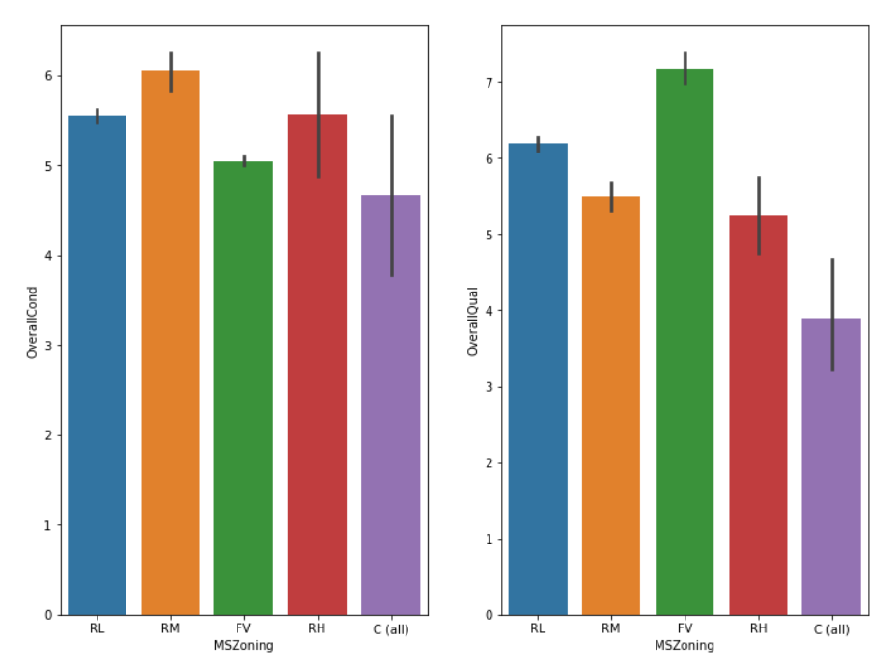

Slide 41
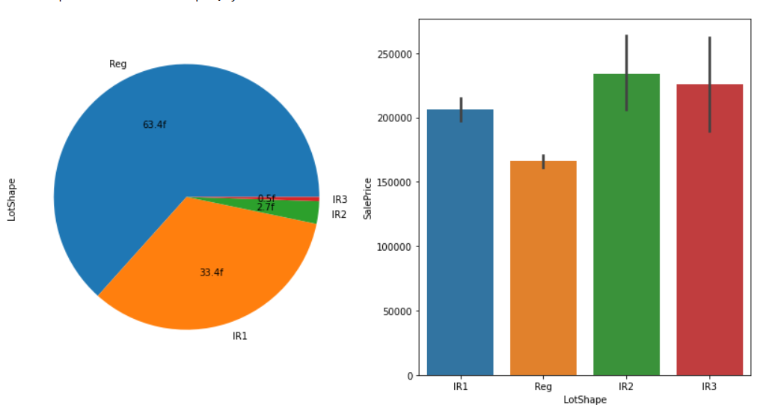
2. OBSERAVTION ON THE BASIS OF LAND
FEATURES:-
*Reg-Regular
*IR1-Slightly irregular
*IR2-Moderately Irregular
*IR3-Irregular
OBSERVATION:-
* 63% REGULAR SHAPE TAKE PLACE
* BUT SALE OF MODERATELY IRREGULAR IS HIGHEST THEN FOLLOWED BY SLIGHTLY IRREGULAR

Slide 42
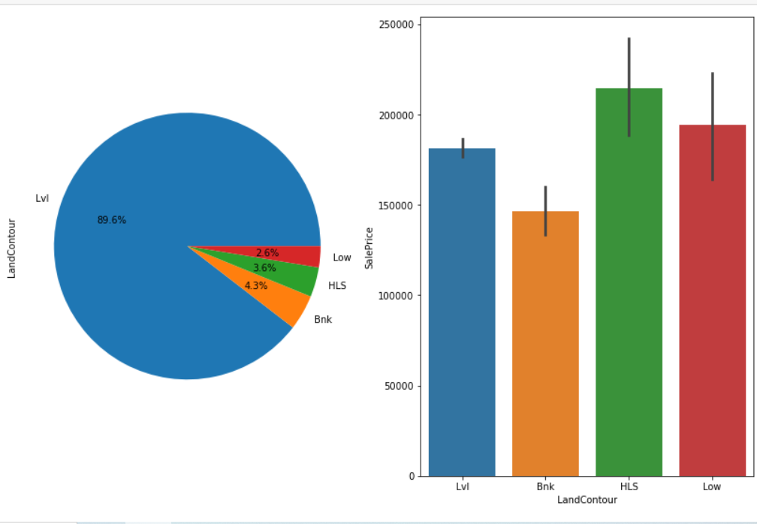
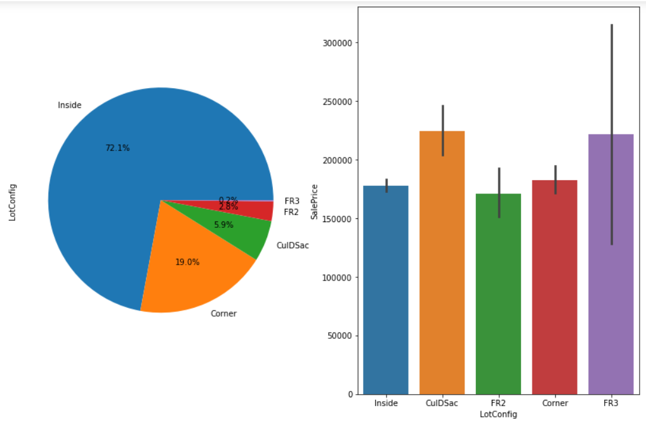

Slide 43
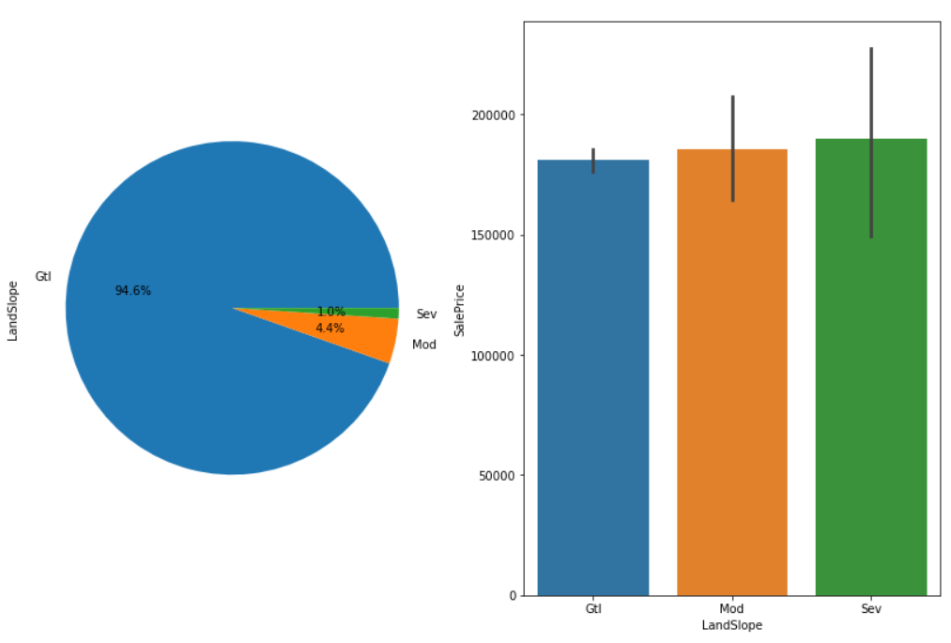
FEATURES OF LAND:-
LandContour: Flatness of the propert
Lvl Near Flat/Level
Bnk Banked - Quick and significant rise from street grade to building
HLS Hillside - Significant slope from side to side
Low Depression

Slide 44
LotConfig: Lot configuration
Inside Inside lot
Corner Corner lot
CulDSac Cul-de-sac
FR2 Frontage on 2 sides of property
FR3 Frontage on 3 sides of property
LandSlope: Slope of property
Gtl Gentle slope
Mod Moderate Slope
Sev Severe Slope
OBSERVATION:-
1.LANDCONTOUR
*89% LAND IS Near Flat/Level FOLLOWED BY Banked - Quick and significant rise from street grade to building WITH 4.3%
*Hillside - Significant slope from side to side HAS HIGHEST SALE PRICE FOLLOWED BY Depression
2.Lot configuration
*72.1% IS INSIDE LOT FOLLOWED BY 19% CORNER LOT
*Cul-de-sac IS HIGHEST SALE PRICE FOLLOWED BY Frontage on 3 sides of property

Slide 45
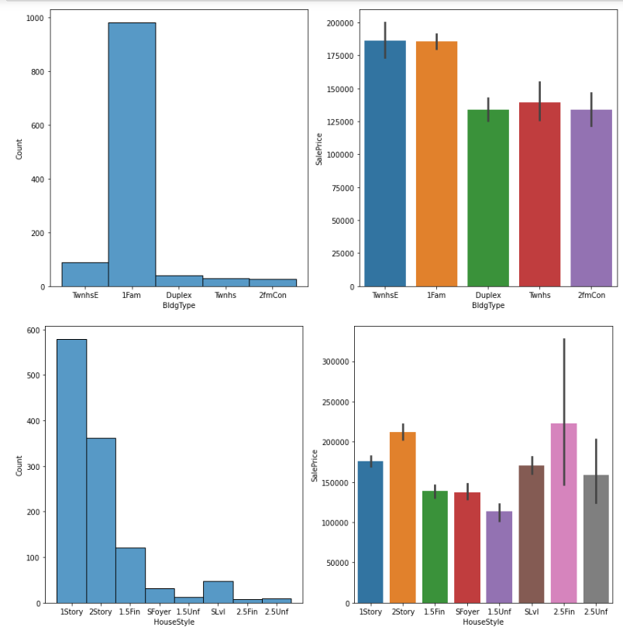
3.Slope of property
*94% PROPERTY HAS GENTEL SLPOE FOLLOWED BY Moderate Slope WITH 4.4%
*Severe Slope HAS HIGHEST SALE PRICE
3. feature of house

Slide 46
FEATURES :-
BldgType: Type of dwelling
1.Fam Single-family Detached
2.FmCon Two-family Conversion; originally built as one-family dwelling
3.Duplx Duplex
4.TwnhsE Townhouse End Unit
5.TwnhsI Townhouse Inside Unit
HouseStyle: Style of dwelling
1Story One story
1.5Fin One and one-half story: 2nd level finished
1.5Unf One and one-half story: 2nd level unfinished
2Story Two story
2.5Fin Two and one-half story: 2nd level finished
2.5Unf Two and one-half story: 2nd level unfinished
SFoyer Split Foyer
SLvl Split Level
#observation:-
*IN Type of dwelling. Single-family Detached HAS HIGHEST COUNT
*IN Style of dwelling. One story HAS HIGHEST COUNT FOLLOWED BY Two story
#SALE OBSRVATION:-
*IN Type of dwelling.Townhouse End Unit AND Single-family Detached HAS HIGHEST SALE PRICE
*IN Style of dwelling.Two and one-half story: 2nd level finished HAS HIGNEST SALE PRICE

Slide 47
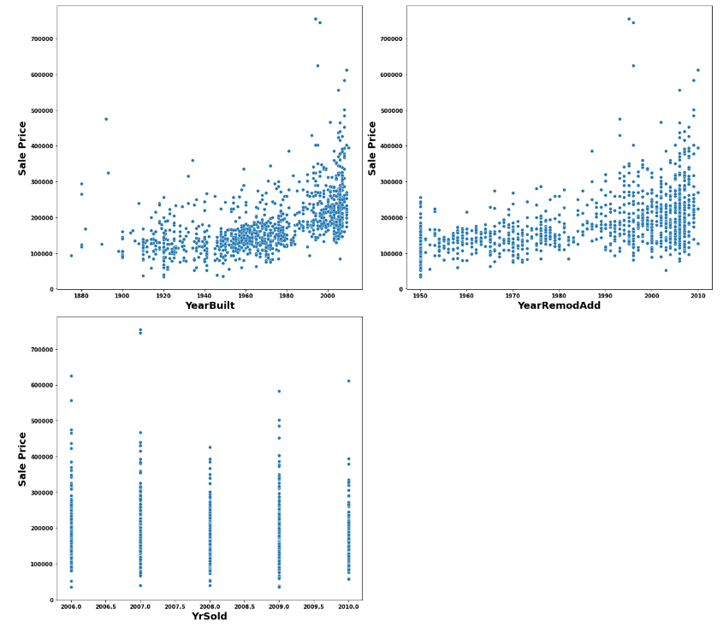
4.YEAR OF PROPERTY

Slide 48
feature:-
*YearBuilt: Original construction date
*YrSold: Year Sold (YYYY)
*YearRemodAdd: Remodel date (same as construction date if no remodeling or additions)
OBSERVATION:-
*We can see that as Property get older with time its sale Price get depricates.
*20 years after Remodelling Price of properties start decreases.
*Older the garage age less the price of Property.
5.ROOF OF PROPERTY
a). style of roof
RoofStyle: Type of roof
Flat Flat
Gable Gable
Gambrel Gabrel (Barn)
Hip Hip
Mansard Mansard
Shed Shed
OBSERVATION:-
*PROPERTY WITH GABLE ROOF TOP STYLE IS HIGHEST
*SHED ROOF TOP PROPRETY HAAS HIGHEST SALE PRICE FOLLOWED BY HIP

Slide 49
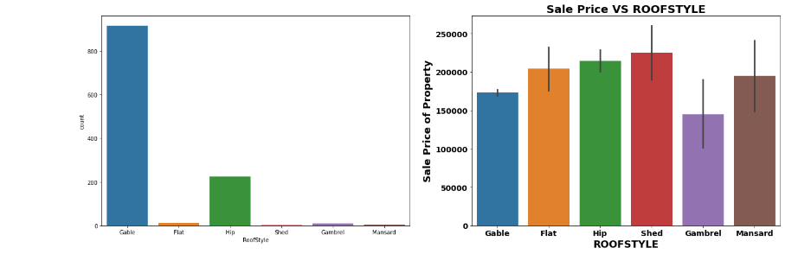
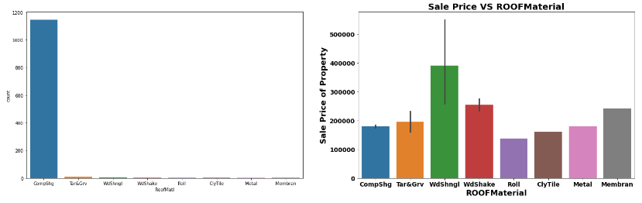
b). material of roof

Slide 50
RoofMatl: Roof material
ClyTile - Clay or Tile
CompShg - Standard (Composite) Shingle
Membran - Membrane
Metal - Metal
Roll - Roll
Tar&Grv - Gravel & Tar
WdShake - Wood Shakes
WdShngl - Wood Shingles
OBSERVATION:-
*standard shingle has been highest used in roof material
*wood shingles has the hignest sale price followed by wood shakes

Slide 51
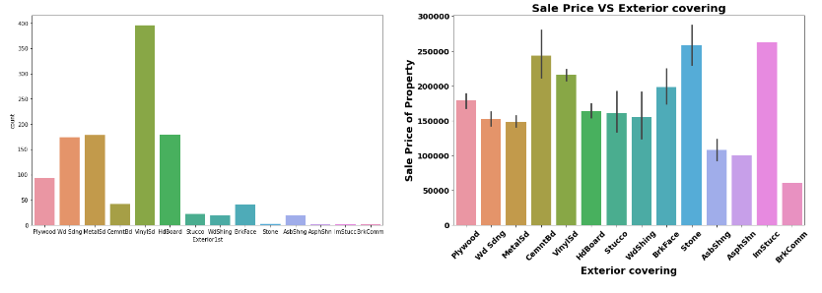
5.EXTERIOR COVERING OF THE HOUSE

Slide 52
Exterior1st-Exterior covering on house
AsbShng-Asbestos Shingles
AsphShn-Asphalt Shingles
BrkComm-Brick Common
BrkFace-Brick Face
CBlock-Cinder Block
CemntBd-Cement Board
HdBoard-Hard Board
ImStucc-Imitation Stucco
MetalSd-Metal Siding
Other-Other
Plywood-Plywood
PreCast-PreCast
Stone-Stone
Stucco-Stucco
VinylSd-Vinyl Siding
Wd Sdng-Wood Siding
WdShing-Wood Shingles
OBSERVATION:-
* as we observed in the figure Vinyl Siding is used highest in the property
*the Stone,Cement Board,Imitation Stucco has the highest sale price

Slide 53
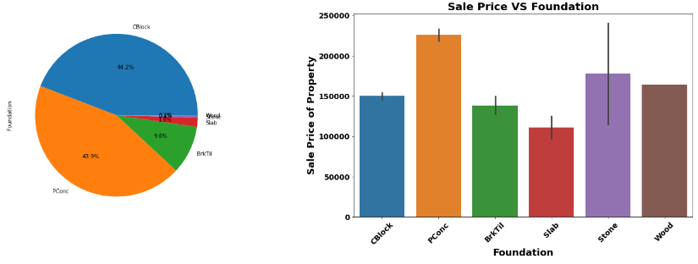
6.Masonry veneer type

Slide 54
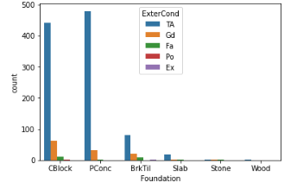
Foundation: Type of foundation
BrkTil Brick & Tile
CBlock Cinder Block
PConc Poured Contrete
Slab Slab
Stone Stone
Wood Wood
OBSERVATION:-
*44.2 % cinder block used followed by poured contrete
*where the poured has been used the sale price increaced followed by stone
A)FOUNDATION AND QUALITY PLOT:-

Slide 55
ExterCond: Evaluates the present condition of the material on the exterior
Ex Excellent
Gd Good
TA Average/Typical
Fa Fair
Po Poor
OBSERVATION:-
*poured contrete has the good condition followed by cinder block

Slide 56
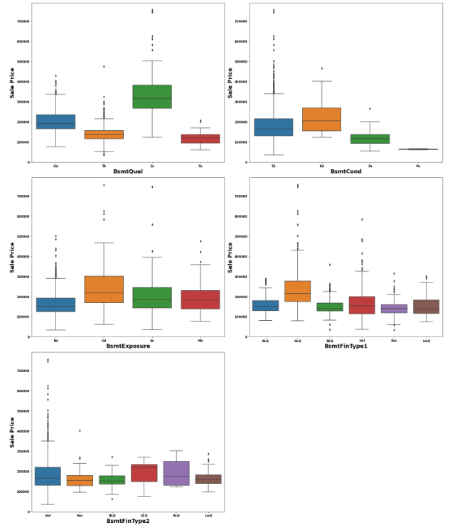

Slide 57
BsmtQual: Evaluates the height of the basement
Ex Excellent (100+ inches)
Gd Good (90-99 inches)
TA Typical (80-89 inches)
Fa Fair (70-79 inches)
Po Poor (<70 inches
NA No Basement
BsmtCond: Evaluates the general condition of the basement
Ex Excellent
Gd Good
TA Typical - slight dampness allowed
Fa Fair - dampness or some cracking or settling
Po Poor - Severe cracking, settling, or wetness
NA No Basement
BsmtExposure: Refers to walkout or garden level walls
Gd Good Exposure
Av Average Exposure (split levels or foyers typically score average or above)
Mn Mimimum Exposure
No No Exposure
NA No Basement

Slide 58
BsmtQual: Evaluates the height of the basement
BsmtFinType1: Rating of basement finished area
GLQ Good Living Quarters
ALQ Average Living Quarters
BLQ Below Average Living Quarters
Rec Average Rec Room
LwQ Low Quality
Unf Unfinshed
NA No Basement
BsmtFinType2: Rating of basement finished area (if multiple types)
GLQ Good Living Quarters
ALQ Average Living Quarters
BLQ Below Average Living Quarters
Rec Average Rec Room
LwQ Low Quality
Unf Unfinshed
NA No Basement

Slide 59
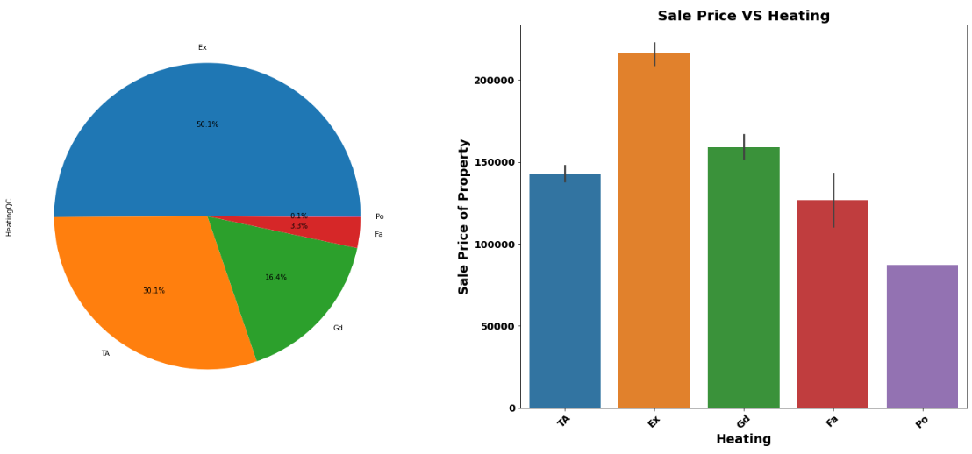
7.heating effect

Slide 60
HeatingQC: Heating quality and condition
Ex Excellent
Gd Good
TA Average/Typical
Fa Fair
Po Poor
OBSERVATION:-
*50% HOUSE HAS EXCELENT HEATING QUALITY FOLLOWED BY AVERAGE/TYPICAL WITH 30.1%
*EXCELENT HAS HIGNEST SALE PRICE GOLLOWED BY GOOD

Slide 61
Key Findings and Conclusions of the Study
Algorithm R2 Score CVScore RandomForest Regressor 90.27 83.12%
XGB Regressor 86.67 82.05% Linear Regression 82.41 76.59% Decision Tree Regressor 50.27 67.25% Extra Tree Regressor 89.65 83.36% Ridge Regression 87.37 78.82% Random Forest Regressor Hyper Parameter Tuned Final Model
90.06 84.56%
➢ Random Forest Regressor giving us maximum R2 Score, so Random Forest Regressor is selected as best model.
➢ After hyper parameter tuning Final Model is giving us R2 Score of 90.27% which is slightly decread compare to earlier R2 score of 90.06%.

Slide 62
Limitations of this work and Scope for Future Work
➢ ANN can be used create more accurate model.
➢ Some additional feature can be added to data which enable us to perform Time series analysis.

